Slide 1
Interview Questions VERILOG

Slide 2
Write a verilog code to swap contents of two registers with and without a temporary register?
With temp reg ; always @ (posedge clock) begin temp=b; b=a; a=temp; end Without temp reg; always @ (posedge clock) begin a <= b; b <= a; end

Slide 3
Tell me about verilog file I/O?
OPEN A FILE integer file; file = $fopenr("filename"); file = $fopenw("filename"); file = $fopena("filename");

Slide 4
The function $fopenr opens an existing file for reading.
$fopenw opens a new file for writing.
$fopena opens a new file for writing where any data will be appended to the end of the file.
The file name can be either a quoted string or a reg holding the file name. If the file was successfully opened, it returns an integer containing the file number (1..MAX_FILES) or NULL (0) if there was an error.
Note that these functions are not the same as the built-in system function $fopen which opens a file for writing by $fdisplay. The files are opened in C with 'rb', 'wb', and 'ab' which allows reading and writing binary data on the PC. The 'b' is ignored on Unix.

Slide 5
CLOSE A FILE integer file, r; r = $fcloser(file); r = $fclosew(file); The function $fcloser closes a file for input. $fclosew closes a file for output. It returns EOF if there was an error, otherwise 0. Note that these are not the same as $fclose which closes files for writing.

Slide 6
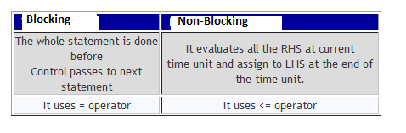
Difference between blocking and non blocking assignment statements?

Slide 7
***Difference between blocking and non-blocking?
The Verilog language has two forms of the procedural assignment statement: blocking and non-blocking.
The two are distinguished by the = and <= assignment operators.
The blocking assignment statement (= operator) acts much like in traditional programming languages. The whole statement is done before control passes on to the next statement.
The non-blocking (<= operator) evaluates all the right-hand sides for the current time unit and assigns the left-hand sides at the end of the time unit.

Slide 8
// testing blocking and non-blocking assignment
module blocking; reg [0:7] A, B; initial begin: init1 A = 3; #1 A = A + 1; // blocking procedural assignment B = A + 1; $display("Blocking: A= %b B= %b", A, B ); A = 3; #1 A <= A + 1; // non-blocking procedural assignment B <= A + 1; #1 $display("Non-blocking: A= %b B= %b", A, B ); end endmodule

Slide 9
produces the following output: Blocking: A= 00000100 B= 00000101 Non-blocking: A= 00000100 B= 00000100
The effect is for all the non-blocking assignments to use the old values of the variables at the beginning of the current time unit and to assign the registers new values at the end of the current time unit. This reflects how register transfers occur in some hardware systems.
Blocking procedural assignment is used for combinational logic and non-blocking procedural assignment for sequential

Slide 10
Tell me how blocking and non blocking statements get executed?
Execution of blocking assignments can be viewed as a one-step process: 1. Evaluate the RHS (right-hand side equation) and update the LHS (left-hand side expression) of the blocking assignment without interruption from any other Verilog statement.
A blocking assignment "blocks" trailing assignments in the same always block from occurring until after the current assignment has been completed
Execution of nonblocking assignments can be viewed as a two-step process: 1. Evaluate the RHS of nonblocking statements at the beginning of the time step.
2. Update the LHS of nonblocking statements at the end of the time step.

Slide 11
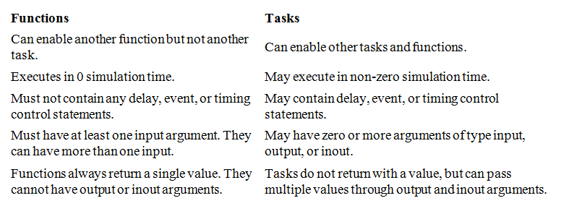
What is the difference between a function and a task?

Slide 12
Difference between inter statement and intra statement delay?
//define register variables reg a, b, c;
//intra assignment delays initial begin a = 0; c = 0; b = #5 a + c; //Take value of a and c at the time=0, evaluate //a + c and then wait 5 time units to assign value //to b. end
//Equivalent method with temporary variables and regular delay control initial begin a = 0; c = 0; temp_ac = a + c; #5 b = temp_ac; //Take value of a + c at the current time and //store it in a temporary variable. Even though a and c //might change between 0 and 5, //the value assigned to b at time 5 is unaffected. end

Slide 13
Difference between $monitor,$display & $strobe?
These commands have the same syntax, and display text on the screen during simulation.
$display and $strobe display once every time they are executed, whereas $monitor displays every time one of its parameters changes.
The difference between $display and $strobe is that $strobe displays the parameters at the very end of the current simulation time unit rather than exactly where it is executed.

Slide 14
Syntax: $display (“format_string”, par_1, par_2, ... ); $strobe (“format_string”, par_1, par_2, ... ); $monitor (“format_string”, par_1, par_2, ... );
The format string is like that in C/C++, and may contain format characters. Format characters include %d (decimal), %h (hexadecimal), %b (binary), %c (character), %s (string) and %t (time), %m (hierarchy level). %5d, %5b etc. would give exactly 5 spaces for the number instead of the space needed. Append b, h, o to the task name to change default format to binary, octal or hexadecimal.

Slide 15
What is difference between Verilog full case and parallel case?
A "full" case statement is a case statement in which all possible case-expression binary patterns can be matched to a case item or to a case default. If a case statement does not include a case default and if it is possible to find a binary case expression that does not match any of the defined case items, the case statement is not "full."
A "parallel" case statement is a case statement in which it is only possible to match a case expression to one and only one case item. If it is possible to find a case expression that would match more than one case item, the matching case items are called "overlapping" case items and the case statement is not "parallel."

Slide 16
What is meant by inferring latches,how to avoid it?
Consider the following : always @(s1 or s0 or i0 or i1 or i2 or i3) case ({s1, s0}) 2'd0 : out = i0; 2'd1 : out = i1; 2'd2 : out = i2; endcase

Slide 17
In a case statement if all the possible combinations are not compared and default is also not specified like in example above a latch will be inferred ,a latch is inferred because to reproduce the previous value when unknown branch is specified.
For example in above case if {s1,s0}=3 , the previous stored value is reproduced for this storing a latch is inferred.
The same may be observed in IF statement in case an ELSE IF is not specified.
To avoid inferring latches make sure that all the cases are mentioned if not default condition is provided.

Slide 18
Variable and signal which will be Updated first?
Signals

Slide 19
Difference between Verilog and vhdl?
Compilation
VHDL.
Multiple design-units (entity/architecture pairs), that reside in the same system file, may be separately compiled if so desired. However, it is good design practice to keep each design unit in it's own system file in which case separate compilation should not be an issue.
Verilog.
The Verilog language is still rooted in it's native interpretative mode. Compilation is a means of speeding up simulation, but has not changed the original nature of the language. As a result care must be taken with both the compilation order of code written in a single file and the compilation order of multiple files. Simulation results can change by simply changing the order of compilation.

Slide 20
Data types
VHDL
A multitude of language or user defined data types can be used. This may mean dedicated conversion functions are needed to convert objects from one type to another. The choice of which data types to use should be considered wisely, especially enumerated (abstract) data types. This will make models easier to write, clearer to read and avoid unnecessary conversion functions that can clutter the code. VHDL may be preferred because it allows a multitude of language or user defined data types to be used.

Slide 21
Verilog.
Compared to VHDL, Verilog data types a re very simple, easy to use and very much geared towards modeling hardware structure as opposed to abstract hardware modeling.
Unlike VHDL, all data types used in a Verilog model are defined by the Verilog language and not by the user.
There are net data types, for example wire, and a register data type called reg.
A model with a signal whose type is one of the net data types has a corresponding electrical wire in the implied modeled circuit.
Objects, that is signals, of type reg hold their value over simulation delta cycles and should not be confused with the modeling of a hardware register.
Verilog may be preferred because of it's simplicity.

Slide 22
Design reusability
VHDL.
Procedures and functions may be placed in a package so that they are avail able to any design-unit that wishes to use them.
Verilog.
There is no concept of packages in Verilog. Functions and procedures used within a model must be defined in the module. To make functions and procedures generally accessible from different module statements the functions and procedures must be placed in a separate system file and included using the `include compiler directive.

Slide 23
Can you tell me some of system tasks and their purpose?
$display, $displayb, $displayh, $displayo, $write, $writeb, $writeh, $writeo.
The most useful of these is $display. This can be used for displaying strings, expression or values of variables.
Here are some examples of usage. $display("Hello oni"); --- output: Hello oni $display($time) // current simulation time. --- output: 460 counter = 4'b10; $display(" The count is %b", counter); --- output: The count is 0010
$reset resets the simulation back to time 0;
$stop halts the simulator and puts it in interactive mode where the user can enter commands;
$finish exits the simulator back to the operating system

Slide 24
Write a Verilog code for synchronous and asynchronous reset?
Synchronous reset, synchronous means clock dependent so reset must not be present in sensitivity disk eg: always @ (posedge clk ) begin if (reset) . . . End
Asynchronous means clock independent so reset must be present in sensitivity list. Eg Always @(posedge clock or posedge reset) begin if (reset) . . . end

Slide 25
What is pli? why is it used?
Programming Language Interface (PLI) of Verilog HDL is a mechanism to interface Verilog programs with programs written in C language. It also provides mechanism to access internal databases of the simulator from the C program.
PLI is used for implementing system calls which would have been hard to do otherwise (or impossible) using Verilog syntax. Or, in other words, you can take advantage of both the paradigms - parallel and hardware related features of Verilog and sequential flow of C - using PLI.

Slide 26
What is PLI?
PLI is programming language interface. Essentialy it is a mechanism to invoke C function inside Verilog. It extends Verilog capabilities by allowing users to define their own utilities. Designers can write their own system tasks by using PLI routine.
Some PLI application include a. Application software like calculator or translator can be written using PLI. b. Can be used to define customized system tasks and routines. c. PLI can be used for customized output display d. It allows users to change internal data structure.

Slide 27
Given the following Verilog code, what value of "a" is displayed? always @(clk) begin a = 0; a <= 1; $display(a); end
Answer: A=0

Slide 28
Explanation
Verilog scheduling semantics basically imply a four-level deep queue for the current simulation time: 1: Active Events (blocking statements) 2: Inactive Events (#0 delays, etc) 3: Non-Blocking Assign Updates (non-blocking statements) 4: Monitor Events ($display, $monitor, etc).
Since the "a = 0" is an active event, it is scheduled into the 1st "queue".
The "a <= 1" is a non-blocking event, so it's placed into the 3rd queue.
Finally, the display statement is placed into the 4th queue.
Only events in the active queue are completed this sim cycle, so the "a = 0" happens, and then the display shows a = 0. If we were to look at the value of a in the next sim cycle, it would show 1.

Slide 29
What is the difference between the following two lines of Verilog code? #5 a = b; a = #5 b;
#5 a = b;
Wait five time units before doing the action for "a = b;".
a = #5 b;
The value of b is calculated and stored in an internal temp register, After five time units, assign this stored value to a.

Slide 30
why is it that "if (2'b01 & 2'b10)..." doesn't run the true case?
You used the bit wise AND operator (&) where you meant to use the logical AND operator (&&).

Slide 31
What is the difference between === and == ?
output of "==" can be 1, 0 or X.
output of "===" can only be 0 or 1.
When you are comparing 2 no's using "==" and if one/both the numbers have one or more bits as "x" then the output would be "X" . But if use "===" output would be 0 or 1.
e.g A = 3'b1x0 B = 3'b10x A == B will give X as output. A === B will give 0 as output.

Slide 32
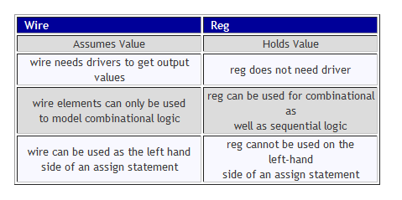
What is the difference between wire and reg?

Slide 33
What do we mean by continuous assignment ?
Continuous assignment is used to drive values to net. Left hand side can be scalar or vector net or concatenation of both while right hand side can be scalar or vector net or register or concatenation of both.

Slide 34
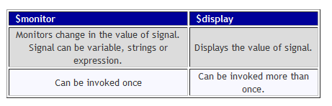
What is the difference between $monitor and $display? $Monitor and $display both system functions and are both used to see the testbench results.

Slide 35
What is $strobe?
It is a synchronization mechanism in which data is displayed only after all other statements are executed unlike $display in which execution order could be nondeterministic.

Slide 36
What is the difference between $setup and $hold?
$setup and $hold is used to monitor setup and hold time constraints for sequential logic. Setup time is the minimum time the data must arrive before active edge of clock signal and hold time is the minimum time the data cannot change after active edge of clock signal. They are specified under specify block.

Slide 37
What is casex and casez statement?
These are the types of case statement in which casex represent x as don't care while casez represent z as don't care.
Don't cares are not allowed in case statement so casex and casez are used.

Slide 38
What is repeat loop in verilog?
Repeat loop is used to execute loop fixed number of times. It is not used to loop expression like we see in while loop statement. It contains constant, variable or signal . For example repeat(8)

Slide 39
What is duty cycle?
Duty Cycle is the fraction of time the signal is high or low. It represents on time of a signal. It can be represented by D=T/P where Dis the duty cycle, T is the time signal is active and P is the total time period of signal.

Slide 40
What is $random?
$random is used to generate random numbers to identify hidden bugs in program. It returns 32 bit number. It returns a new random number each time the function is called. It can also contain as argument which ensures that same random number is generated each time the test is run. The argument for can be register, integer or time variable. $random;
$random();

Slide 41
What do you mean parallel block?
In parallel block all statements are executed concurrently ( i.e., not sequential) They are specified by keyword fork and join. Timing constraints can be provided in parallel block.

Slide 42
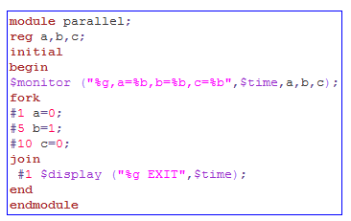
In the above code a gets 0 after 1 time units, b after 5 time unit, c after 10 time units ,EXIT after 11 time units .

Slide 43
What is $time in verilog? $Time function is invoked to get the current simulation time. A time variable is a special register data type to store simulation time. $Time returns 64bit integer value
Example:-
time curr_time;
initial
curr_time = $time;

Slide 44
What is force and release?
These are the second form of procedural continuous assignment. They are used to force and release certain values to registers or nets. They are not used in design block and only used in stimulus block or test bench. They are active for certain period only.

Slide 45
example
module testbench;
//statements
Dff tdff(q,q_bar,d,clk,rst);
initial begin
#50 force tdff.Q = 1'b1; //Force Q to 1 at time 50
#50 release tdff.Q; //relaese Q at time 100
end
//statements
endmodule

Slide 46
What is level sensitive timing control in verilog?
We know that @ is used for edge sensitive timing control but Verilog also provides level sensitive timing control i.e. processor waits for certain expression or condition to be true to execute the statement. This is provided by “wait” statement. Syntax:- wait (expression) statement Here expression is Boolean value i.e. true or false. When true statement is executed. When false it waits for expression to become true.

Slide 47
What are types of compiler directives?
There are four types of compiler directives in Verilog a. define: Used to define text macros. b. include: used to import entire Verilog file to another file. c. ifdef: checks if the macro has been defined or not if defined It compiles the code that follows otherwise compiler compiles the code following an optional else directive d. timescale: specify time unit and time precision of module that follows it.

Slide 48
What are the shift operators in verilog?
Verilog provides a left shift operator using << to shift the bits to the left and right shift operator using >> to shift the bits to the right . We can specify the number of bits that need to shift.
The left shift by one place can be interpreted as multiplication by 2. The left shift by 2 places means multiplication by 4.

Slide 49
What is the output of following code?
module test;
reg[3:0] x;
initial
begin
x =4'b1100;
$display("x before shift = %4b",x);
x = x<<2;
$display("x after shift = %4b",x);
end
endmodule
OUTPUT:
x before shift = 1100
x after shift = 0000

Slide 50
What is the output of following code?
module test;
reg[3:0] x;
reg[5:0] y;
initial
begin
x =4'b1100;
$display("x before shift = %4b",x);
y = x<<2;
$display("y after shift = %6b",y);
end
endmodule
OUTPUT:
x before shift = 1100
y after shift = 110000

Slide 51
What is the output of following code?
module test;
reg[3:0] x;
reg[5:0] y;
initial
begin
x =4'b1100;
$display("x before shift = %4b",x);
y = x>>3;
$display("y after shift = %6b",y);
end
endmodule

Slide 52
Conclusions
The << is used to shift the bits to the left. The LSB bits are padded with 0s after the shift.
The >> is used to shift the bits to the right. The MSB bits are padded with 0s after the shift.
An important consideration in left shift is that the bits are lost
If the variable on the left side of the assignment statement is wider than the variable on the right side of the assignment, the value may be preserved.
This does not apply in case of right shift operator, where the bits shifted out of the right side are not required to be preserved.
The least significant bits in case of right shift operator are always lost.

Slide 53
How the negative numbers are represented in verilog?
A negative number is internally represented as 2's complement in Verilog.

Slide 54
Write a verilog code to find 2’s complents of 5 with 5 bits?
module negativenumbers;
reg [4:0] x;
reg [4:0] y;
initial
begin x = 5;
$display("x = %5b", x );
y = -x;
$display("y = %5b", y );
$finish;
end
endmodule

